Slide 1
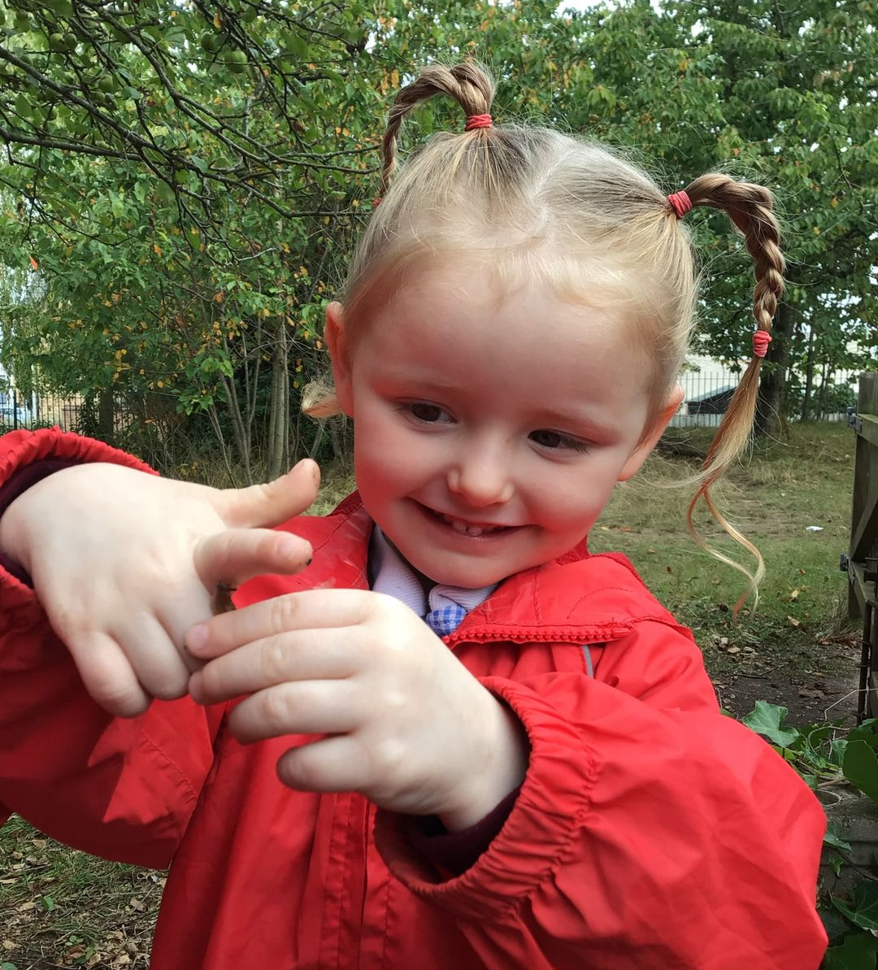

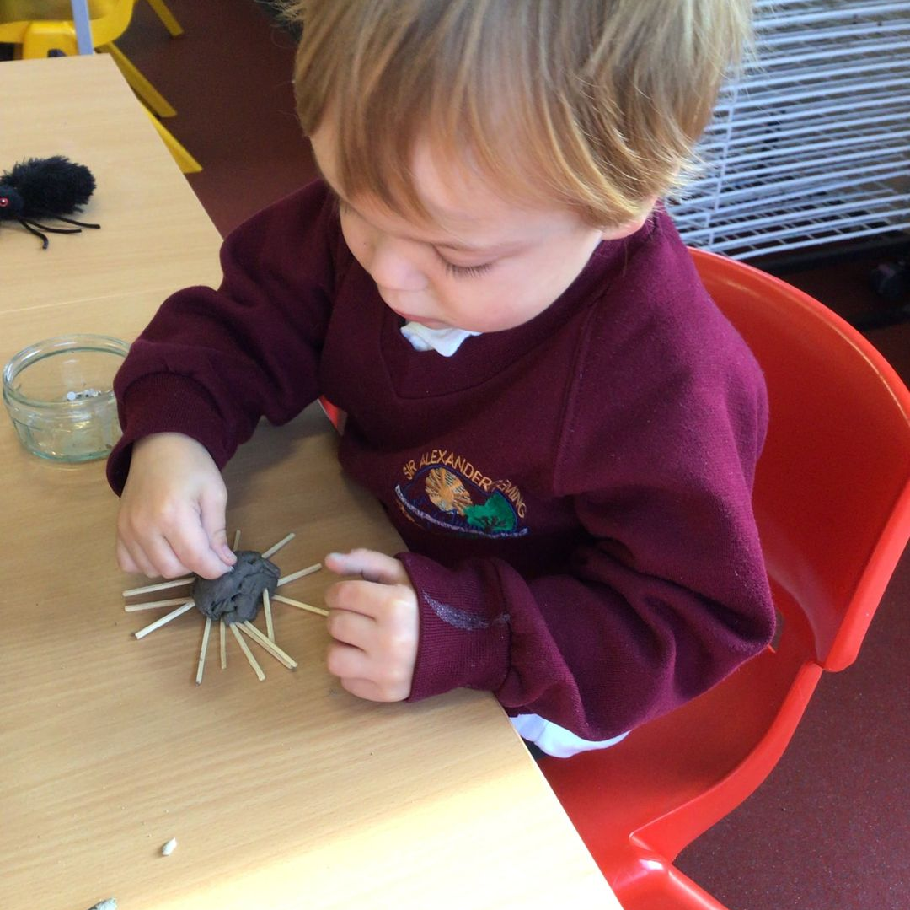
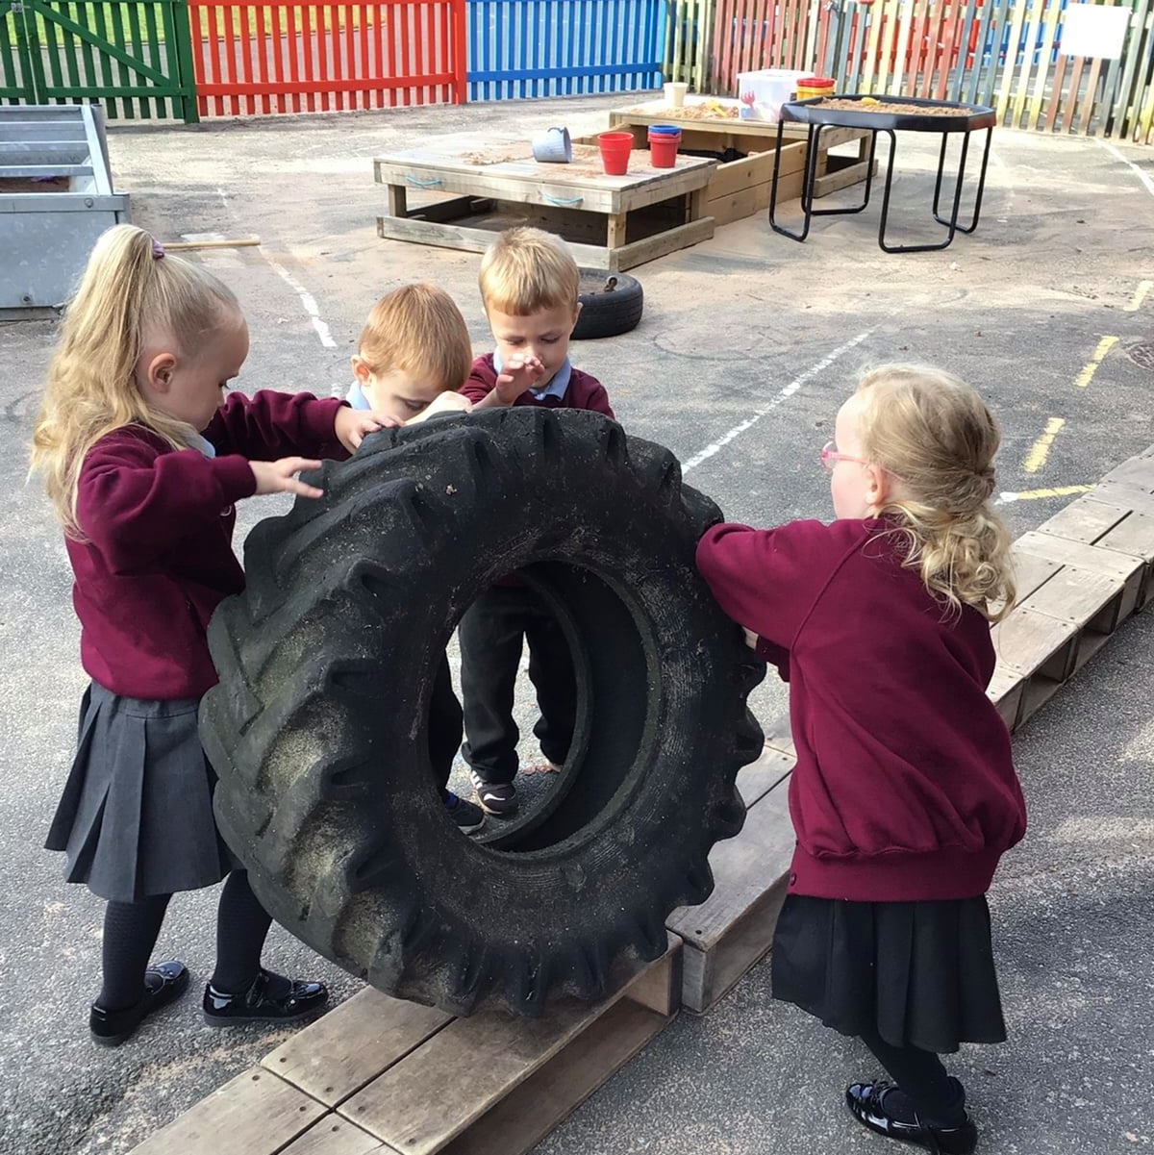
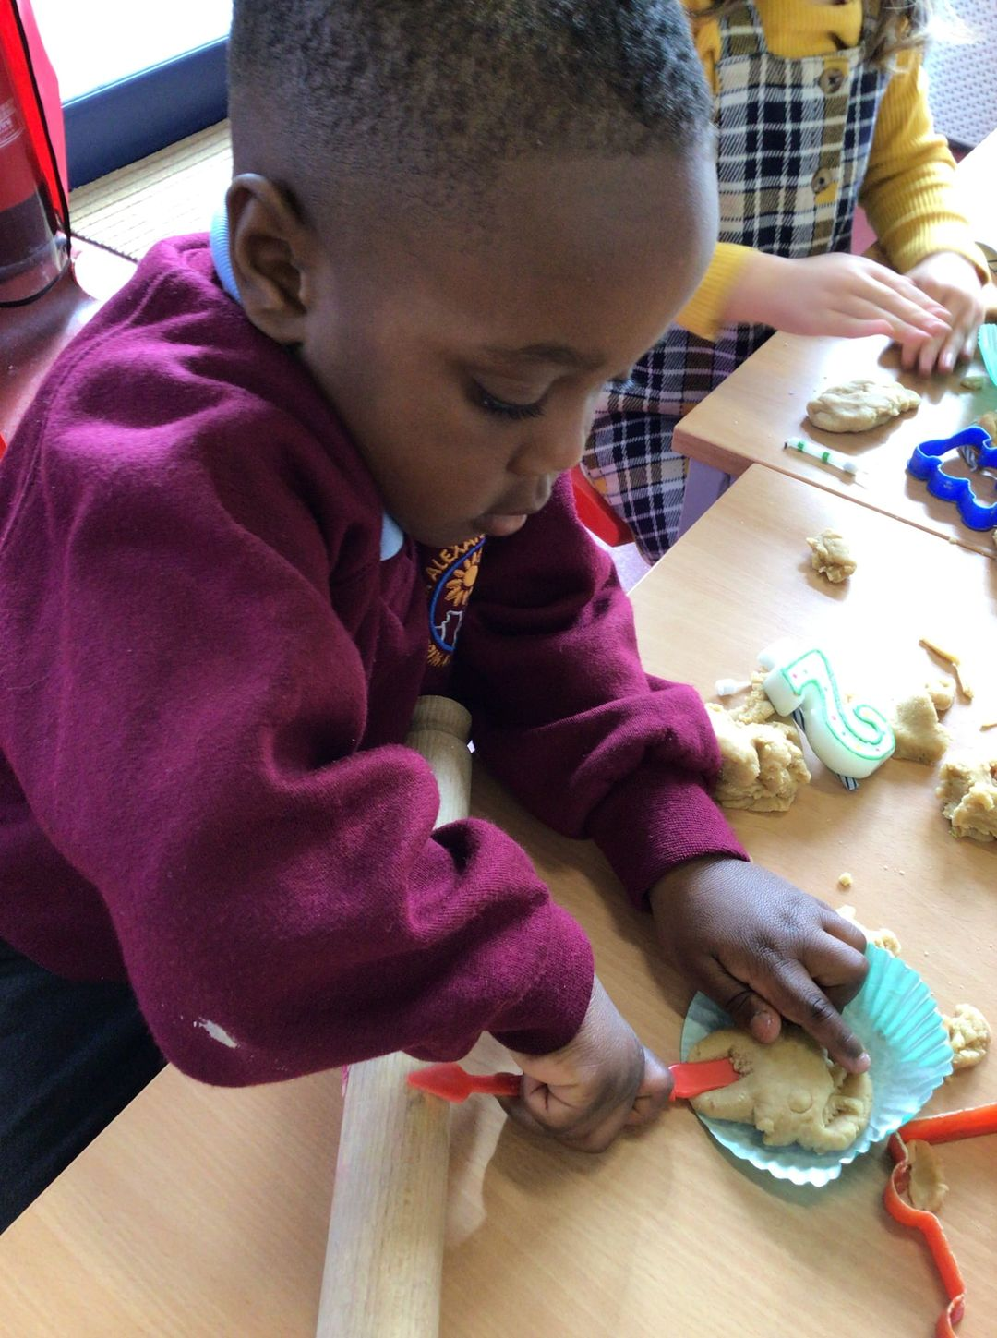

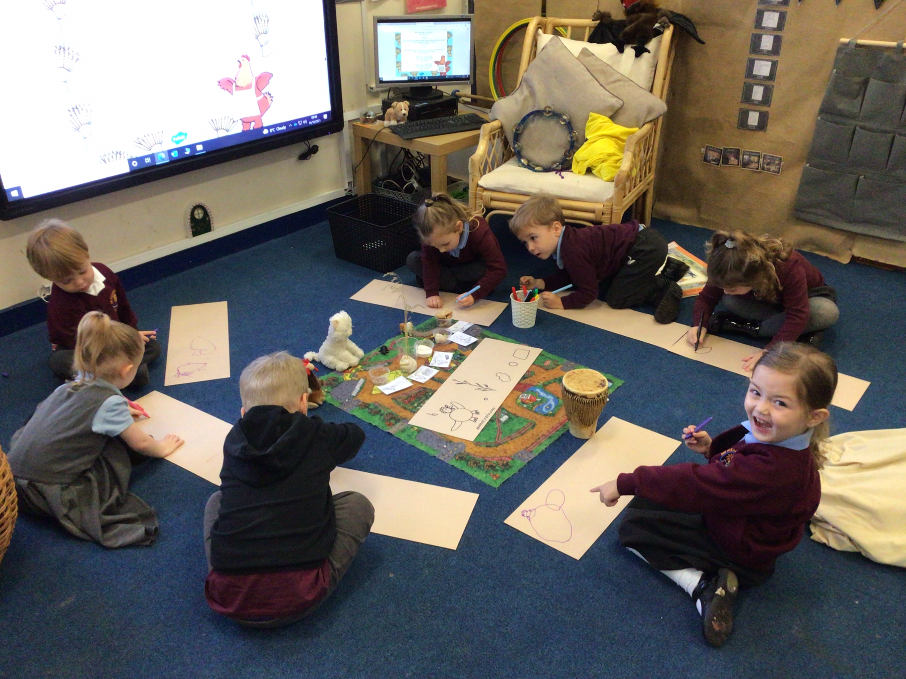
Welcome to Reception
Cohort 2026-27
‘The start of a wonderful journey . . .’

Slide 2
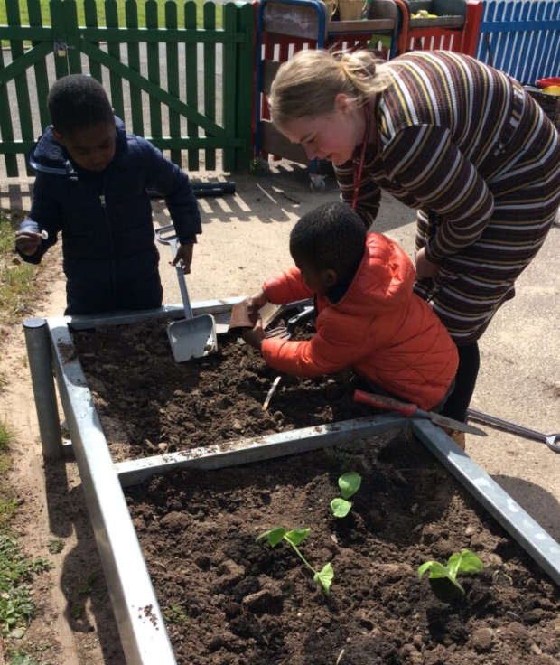
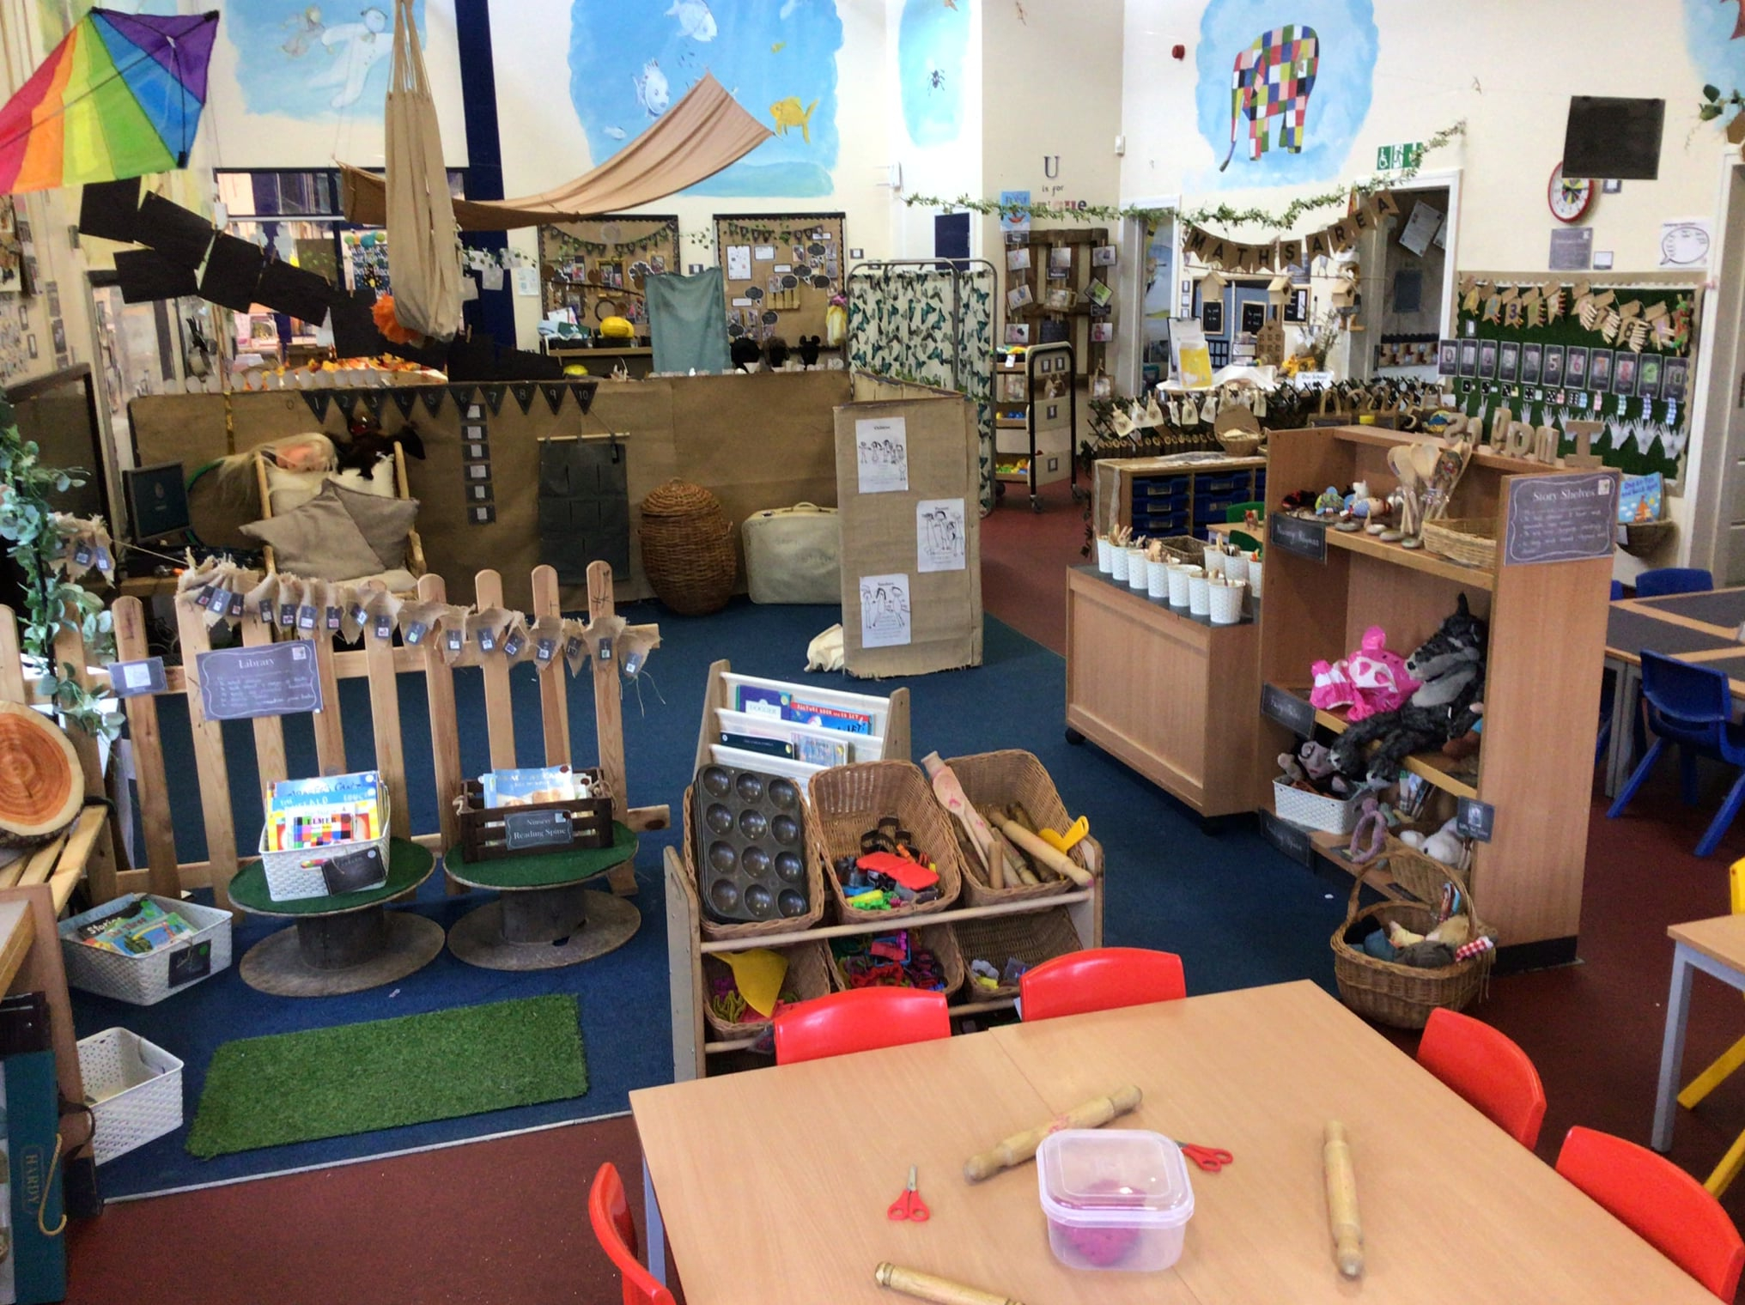
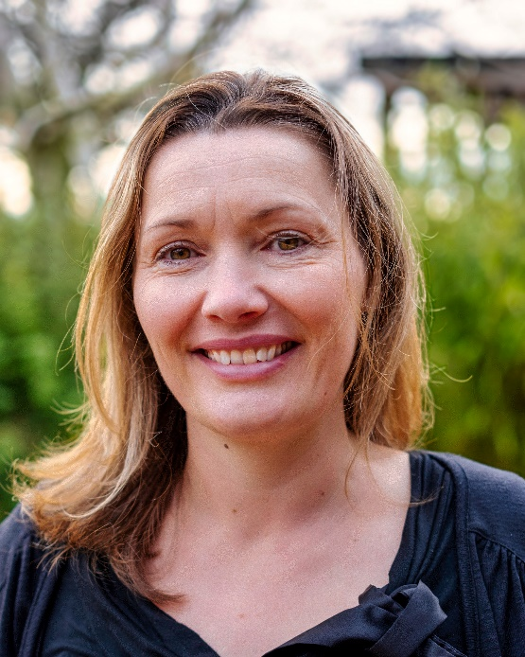
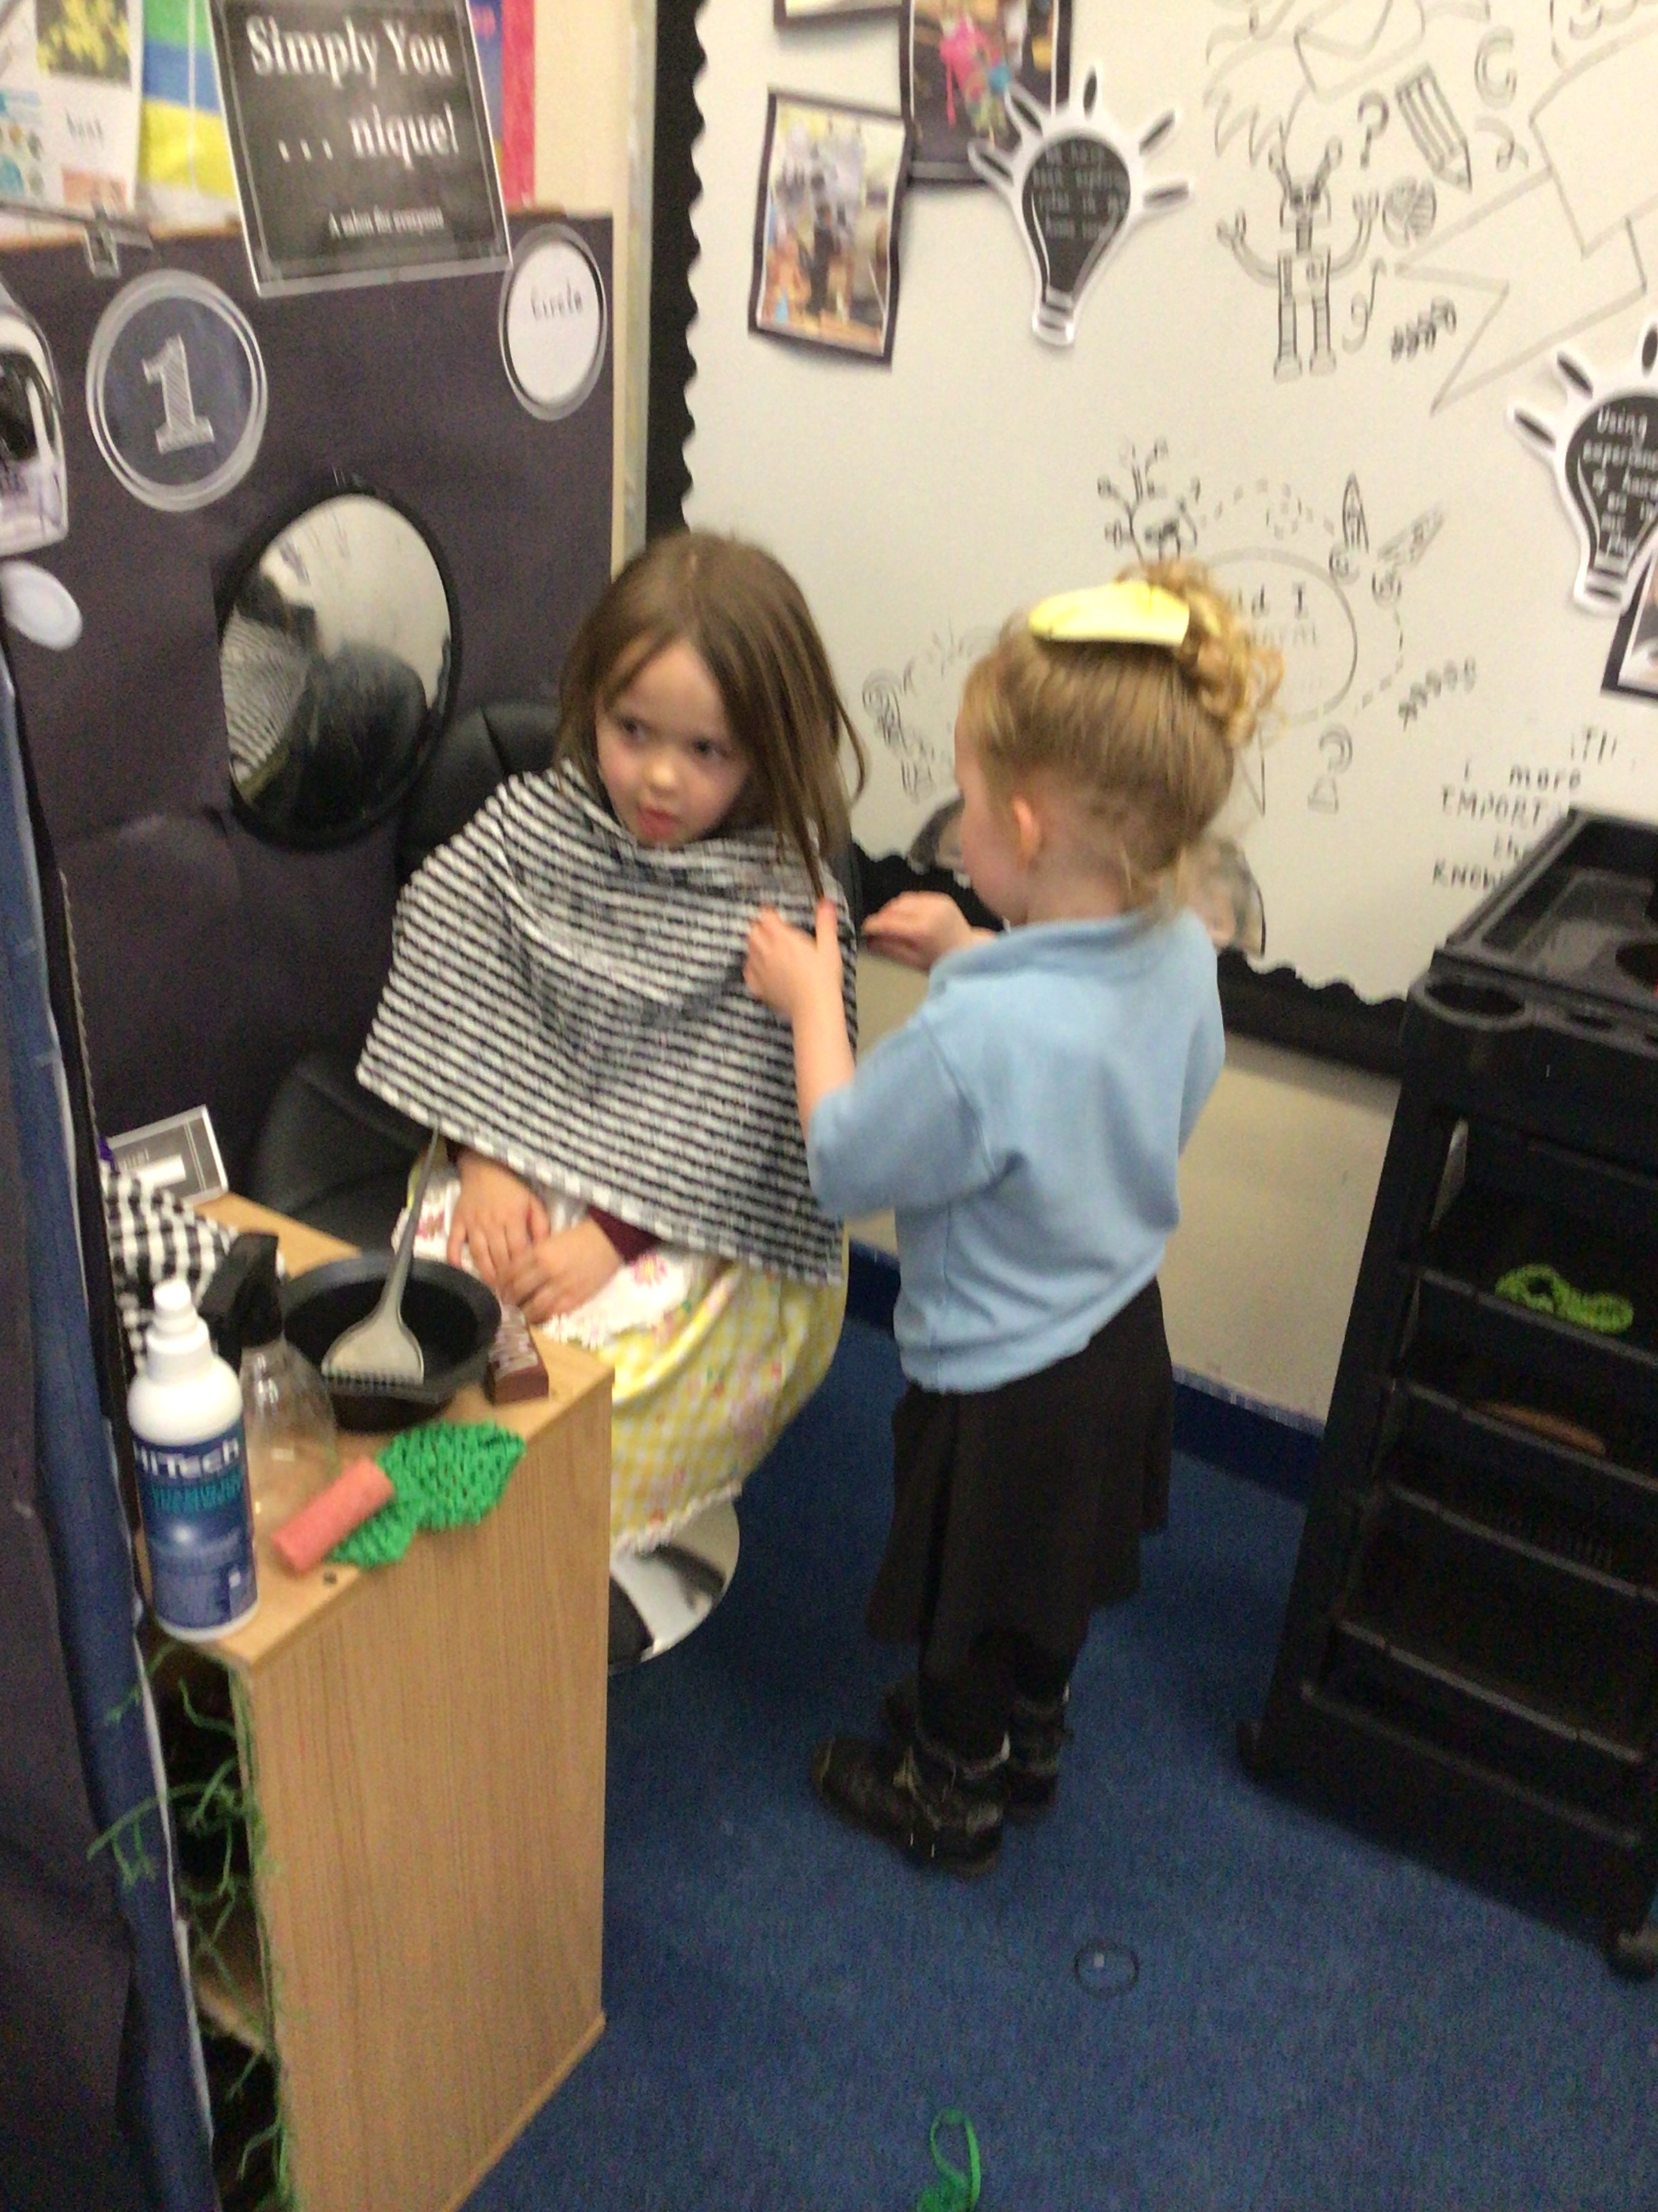
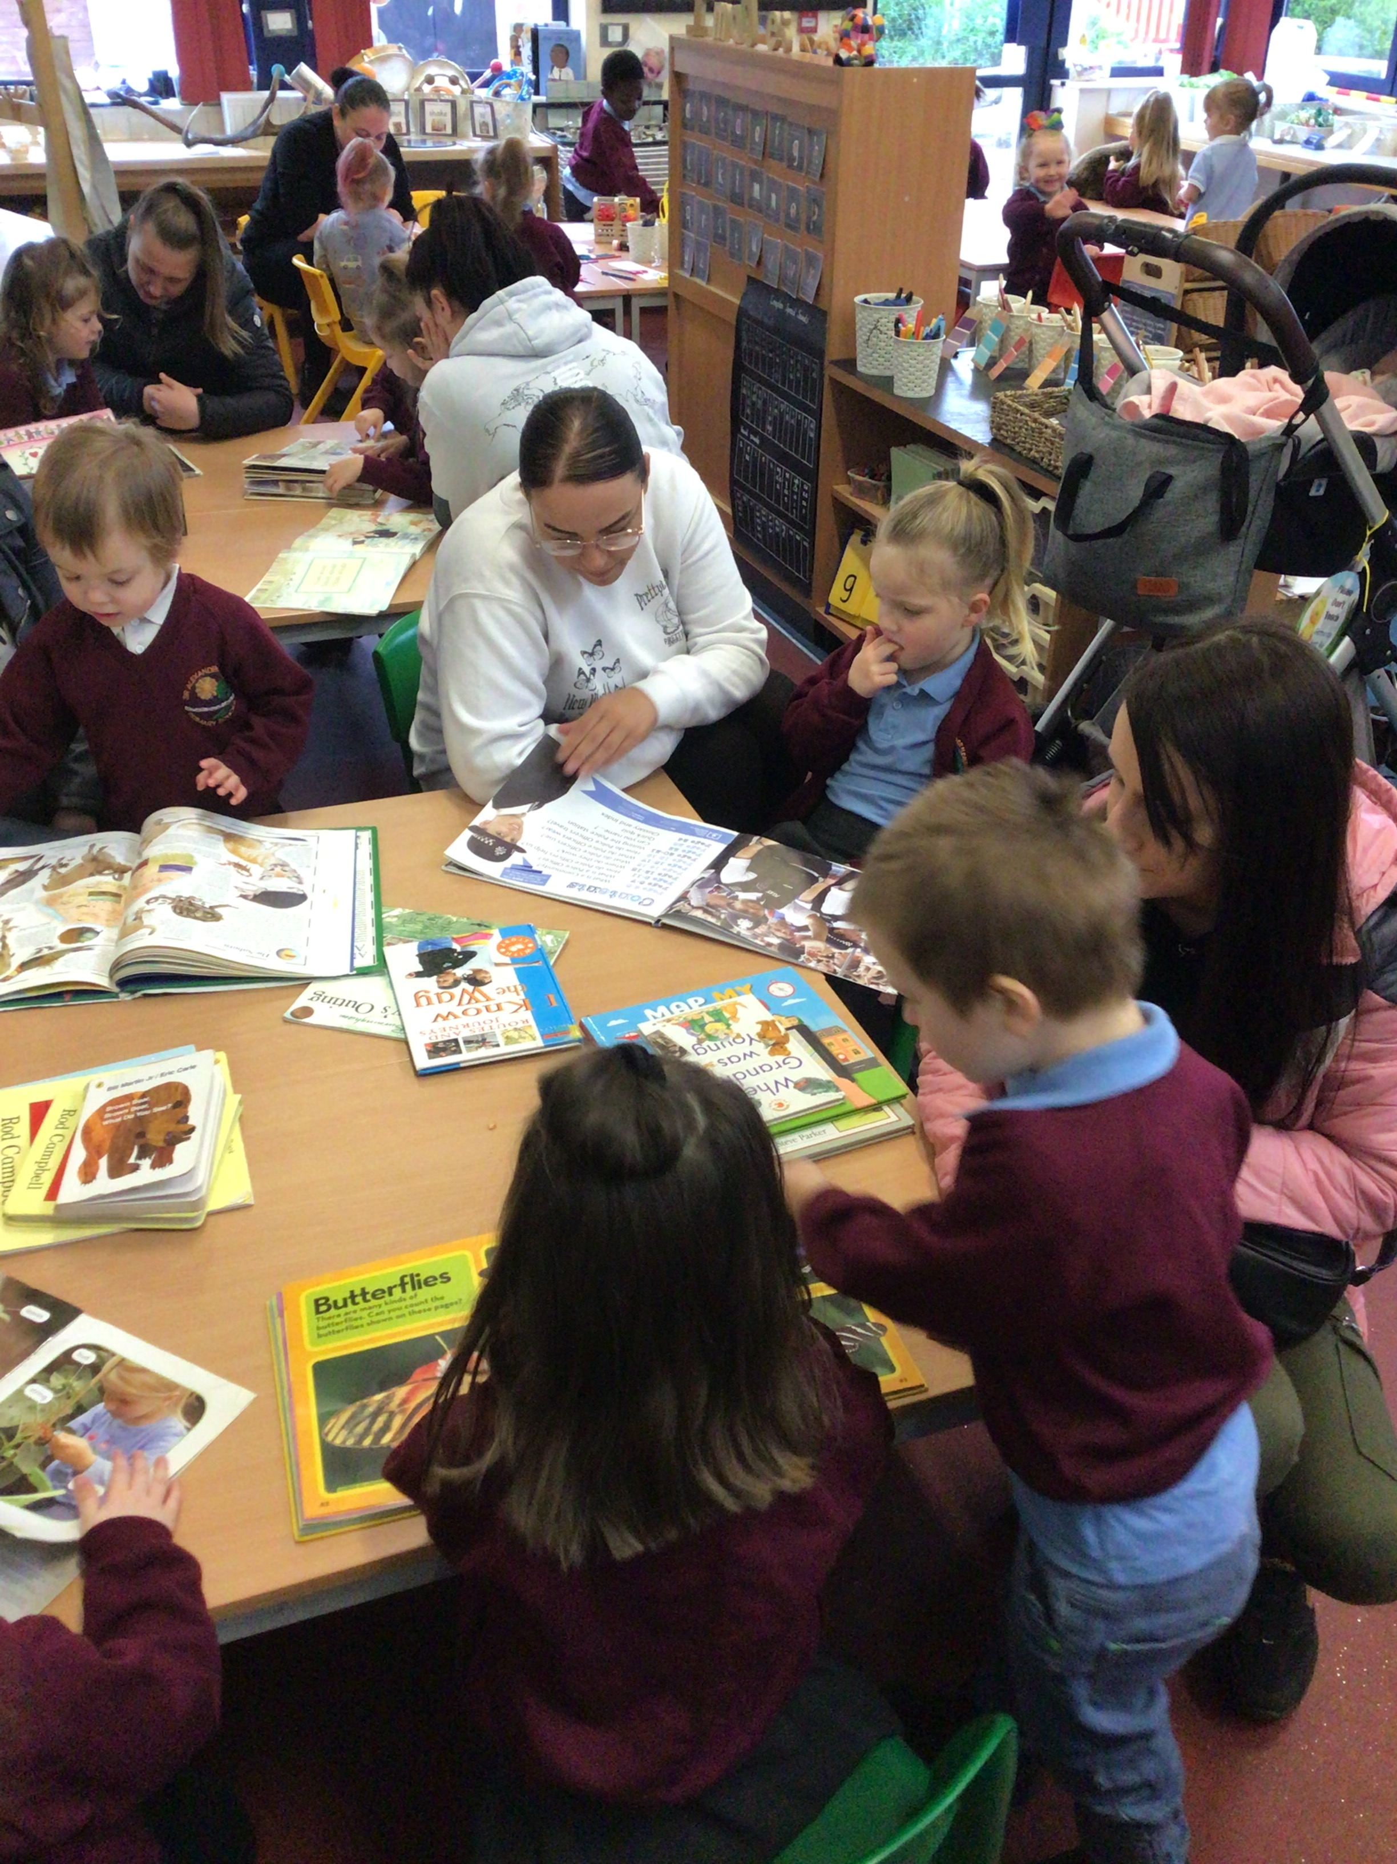
Our Philosophy
Educators
Environment
Learners
Parents

Slide 3
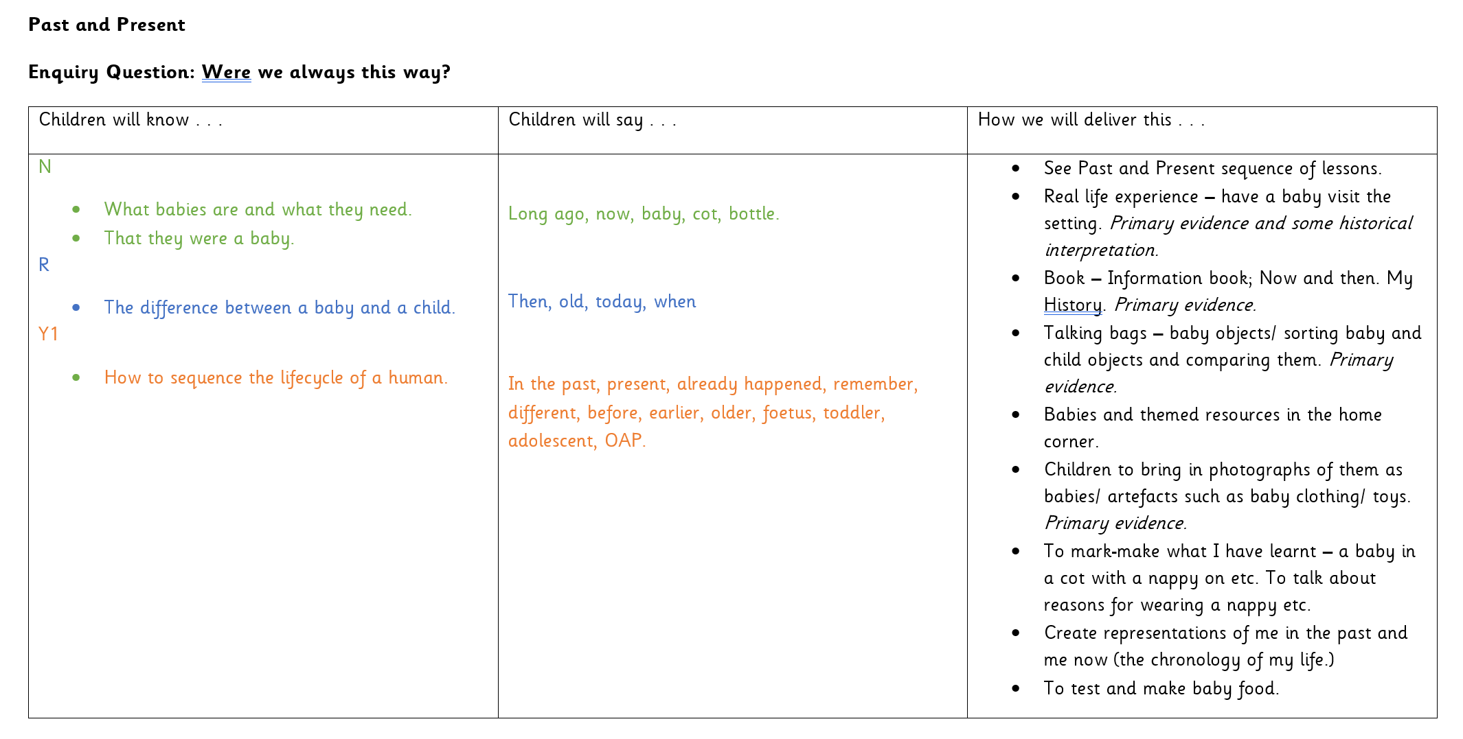
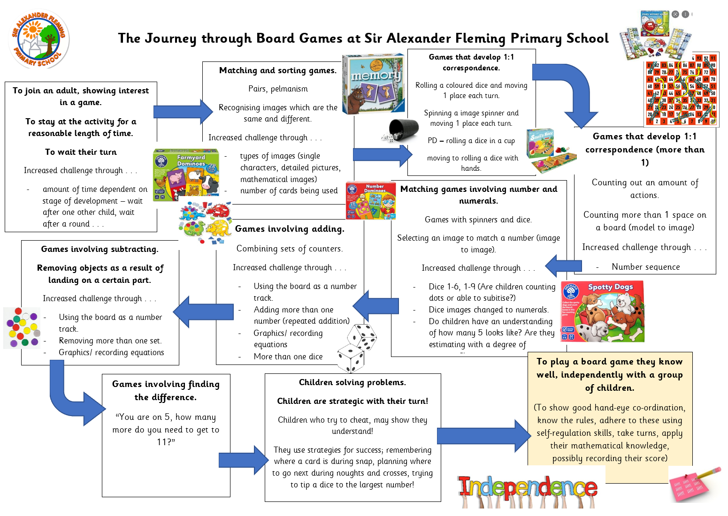
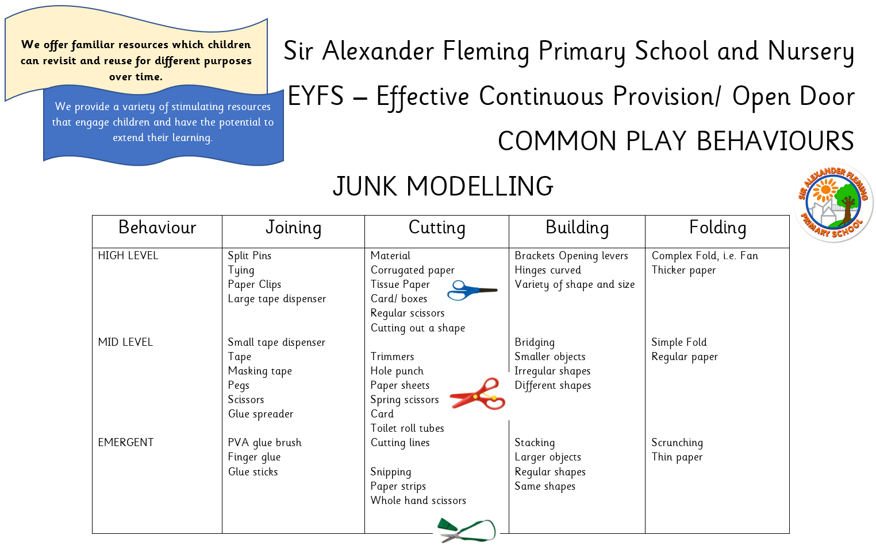
Our Curriculum
Has been uniquely designed by our staff
Has our children at the heart
Is designed to meet children’s interests
Ensure children gain the foundational
knowledge they will need to progress in the
future
Gives children rich experiences

Slide 4
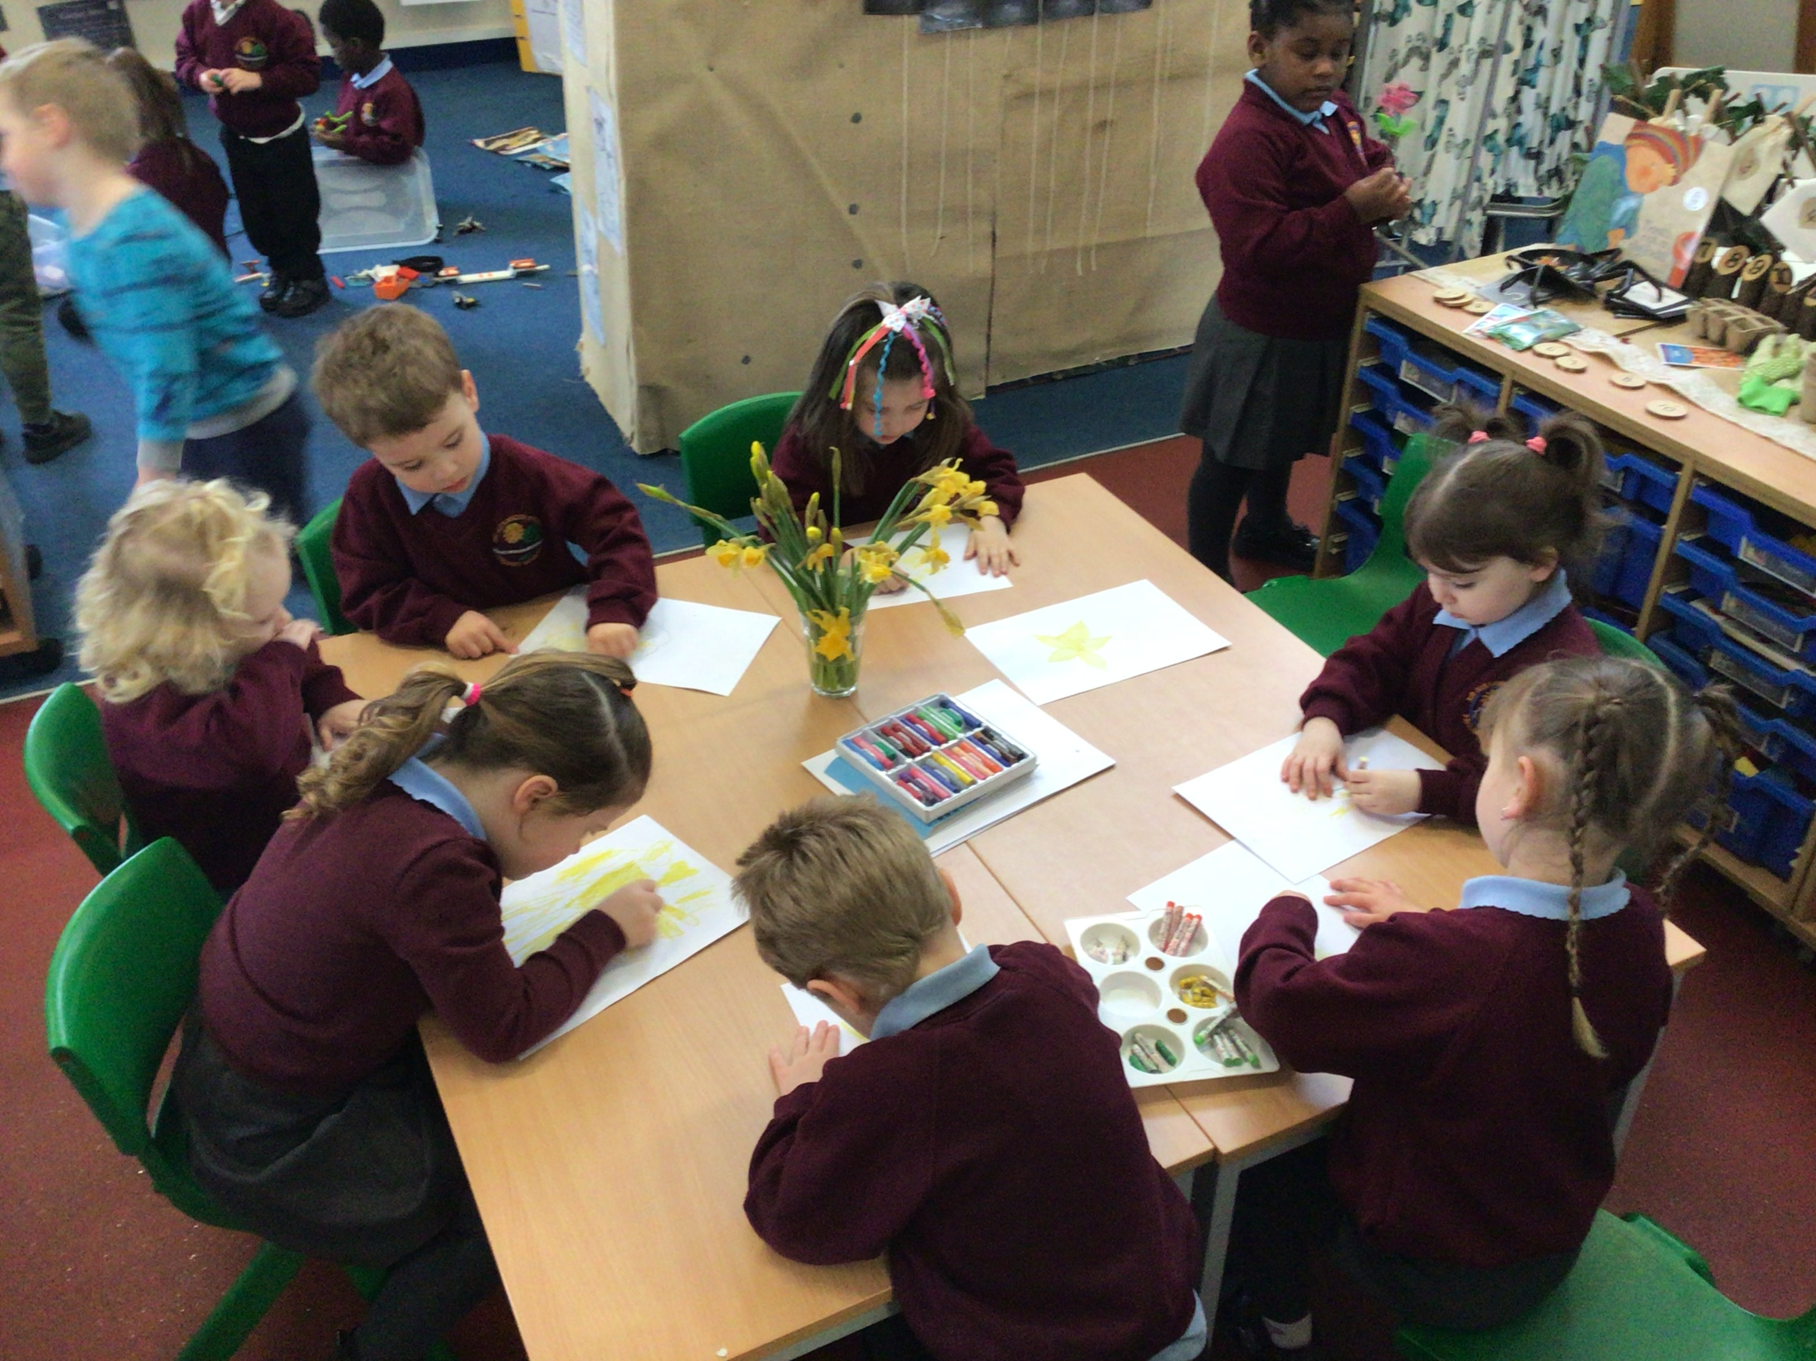
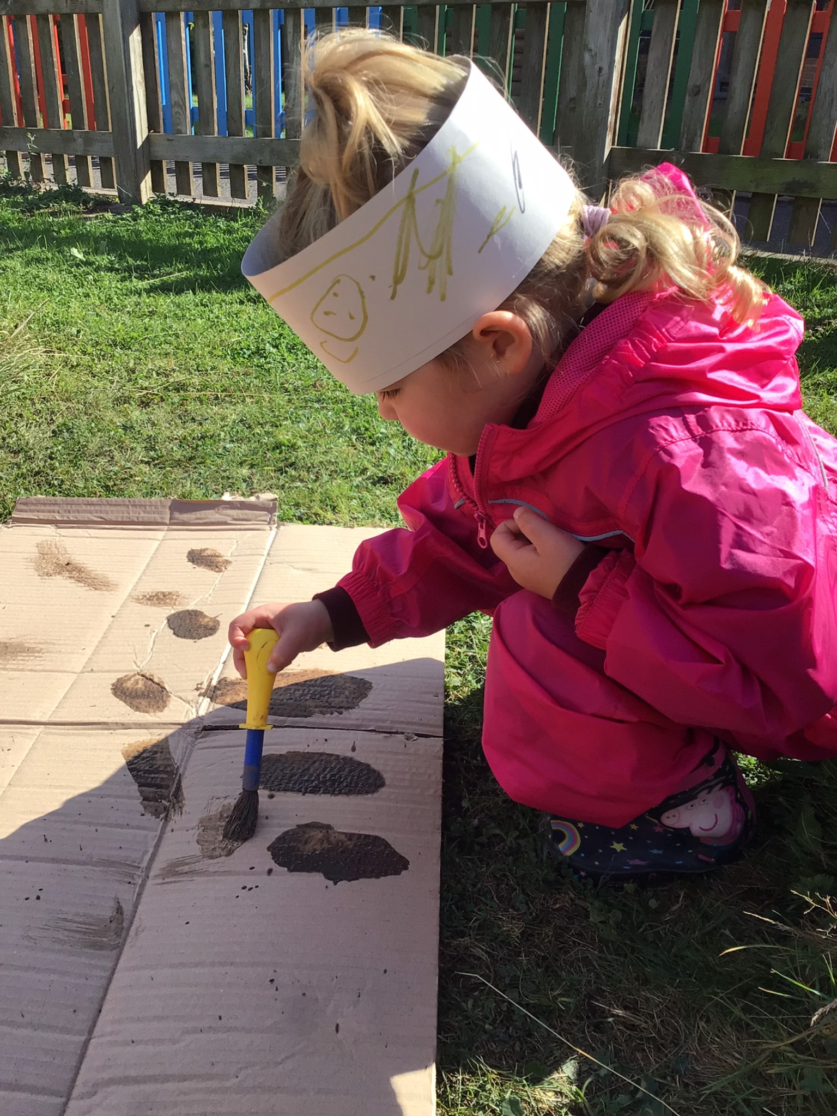
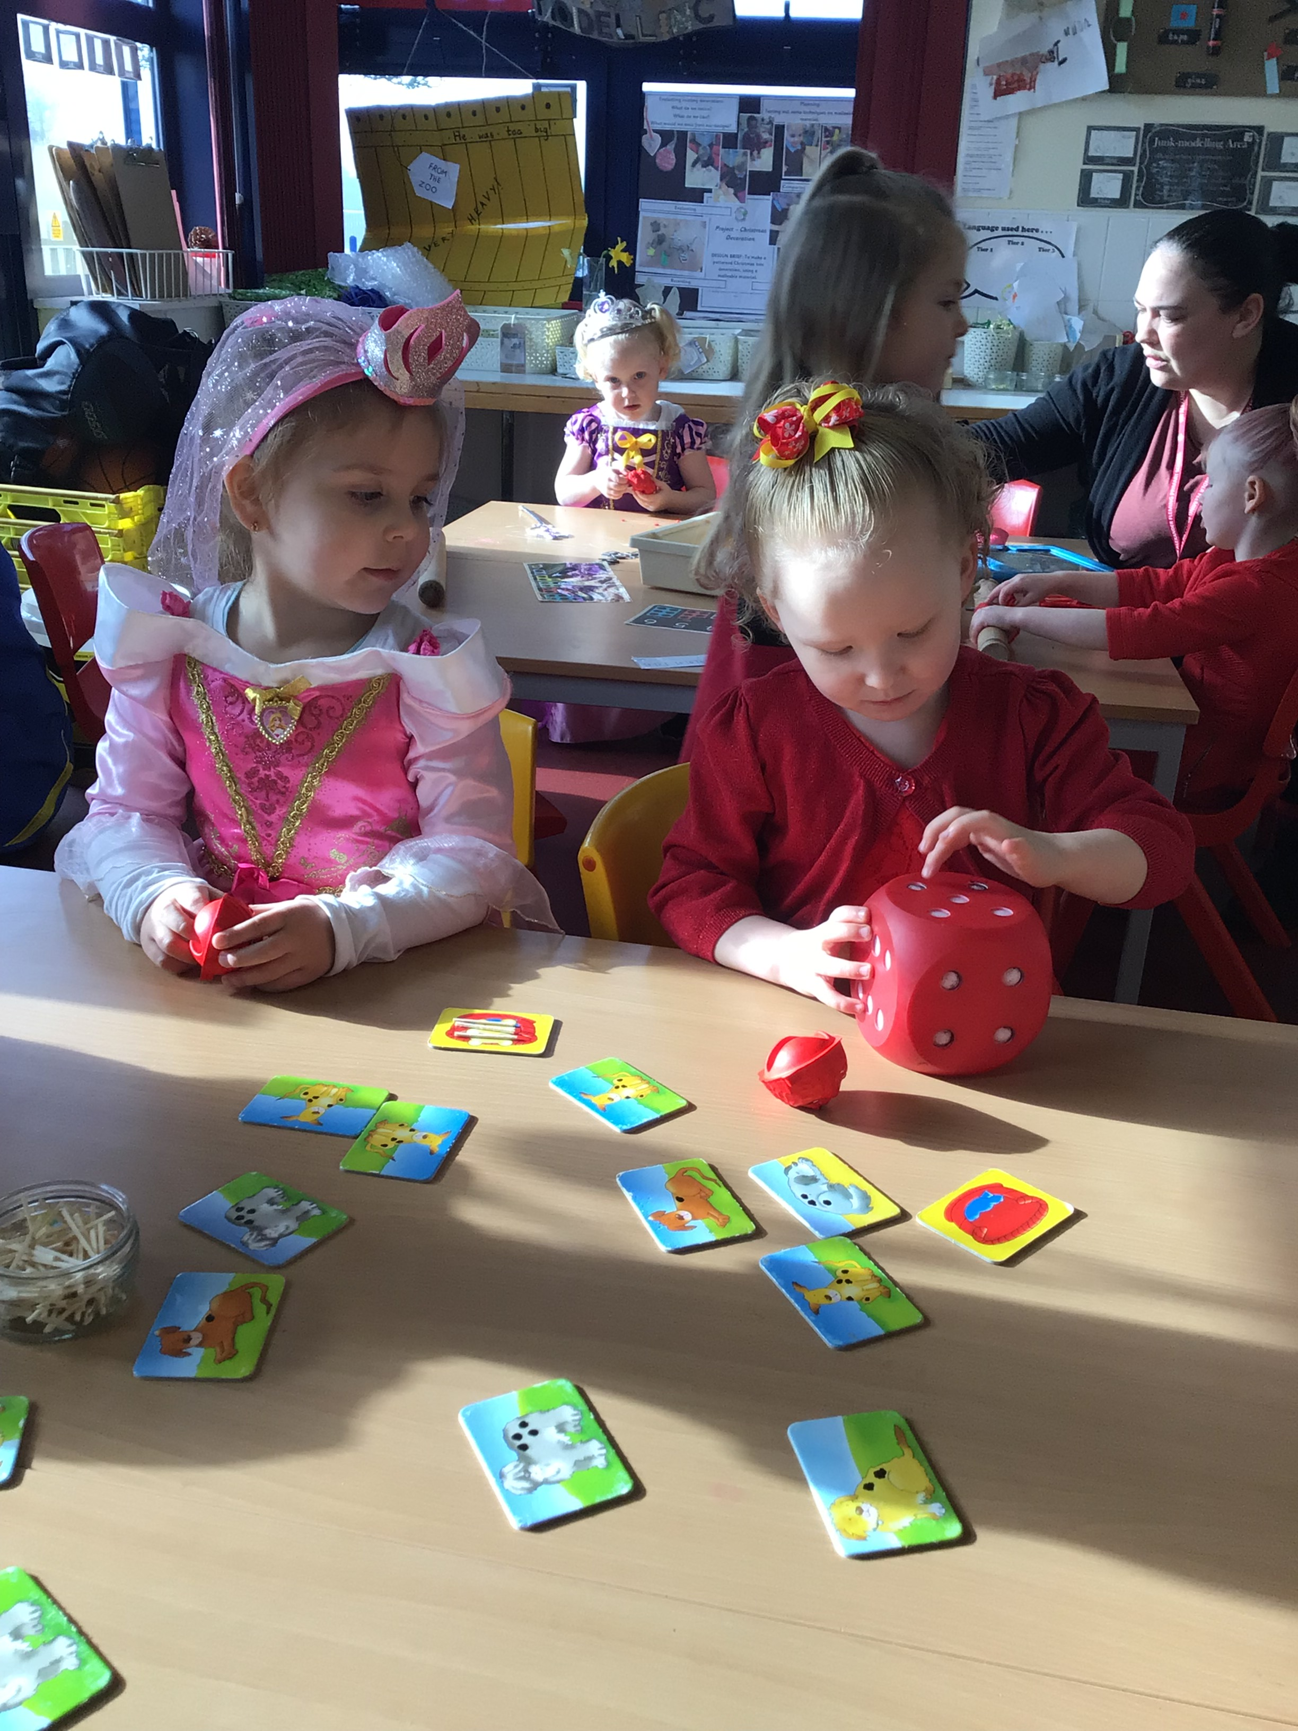
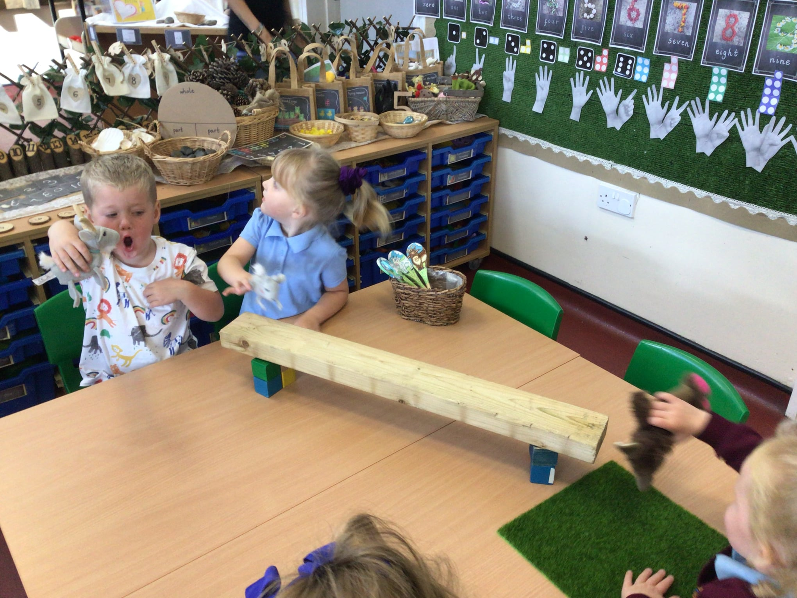

How is the curriculum delivered?
Real, memorable, sensory experiences
Play during Adventure Time
Adult directed tasks
Forest School sessions
Visits and visitors
Quality literature
Nursery rhymes, poetry and songs

Slide 5
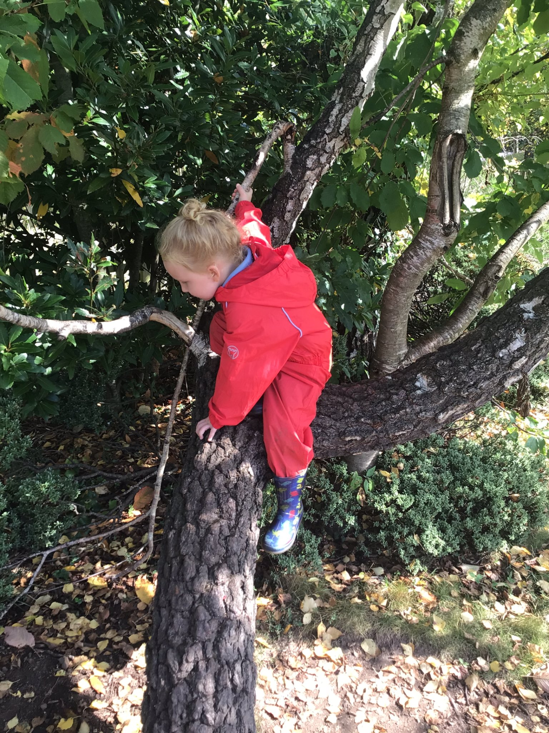
Forest School
“There is no such thing as bad weather . . .”
Supports mental health and develops
emotional intelligence
Develops children’s understanding of the world
and their place within it
Enhances children’s knowledge in all areas of
the curriculum
Gives children a sense of awe and
wonder

Slide 6
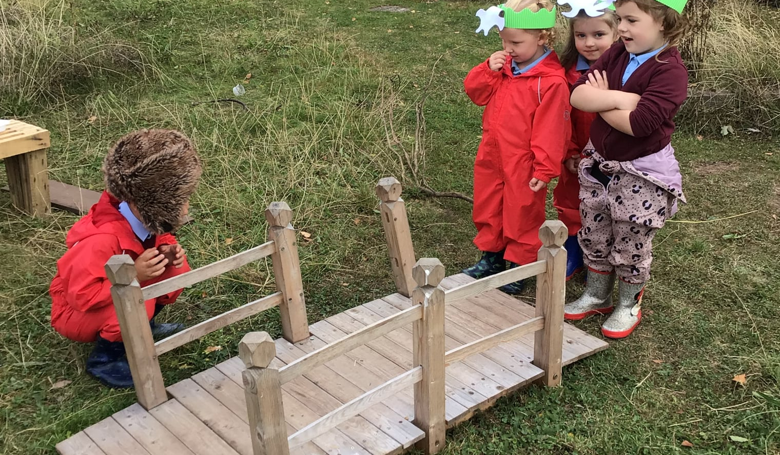
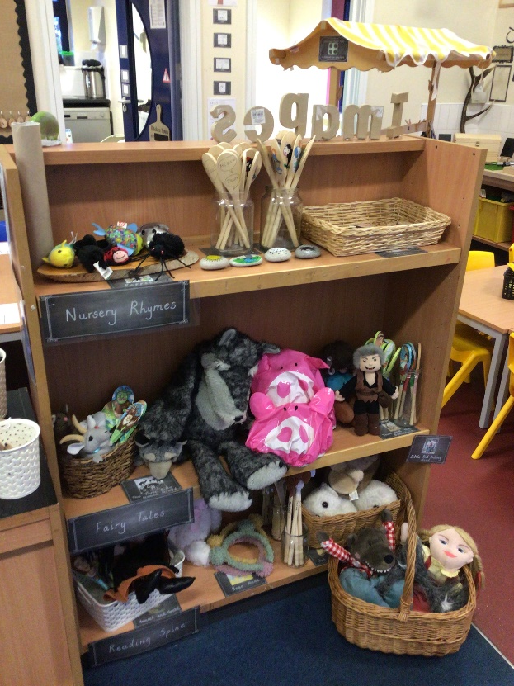

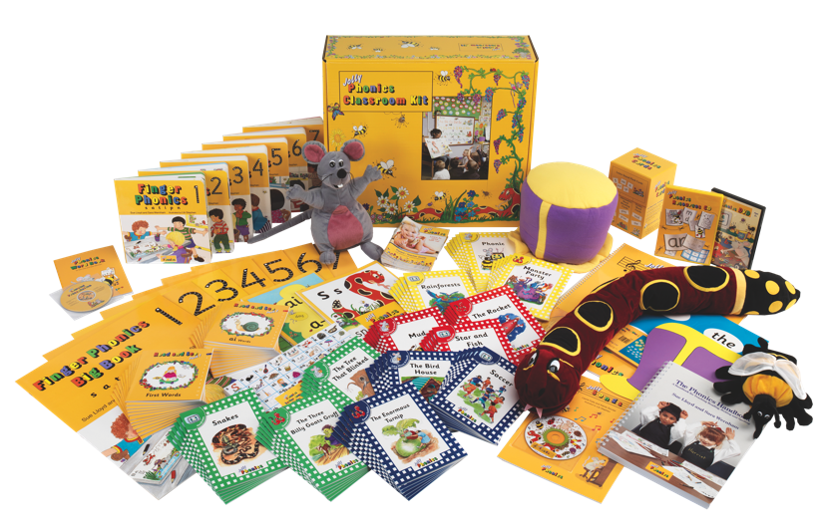
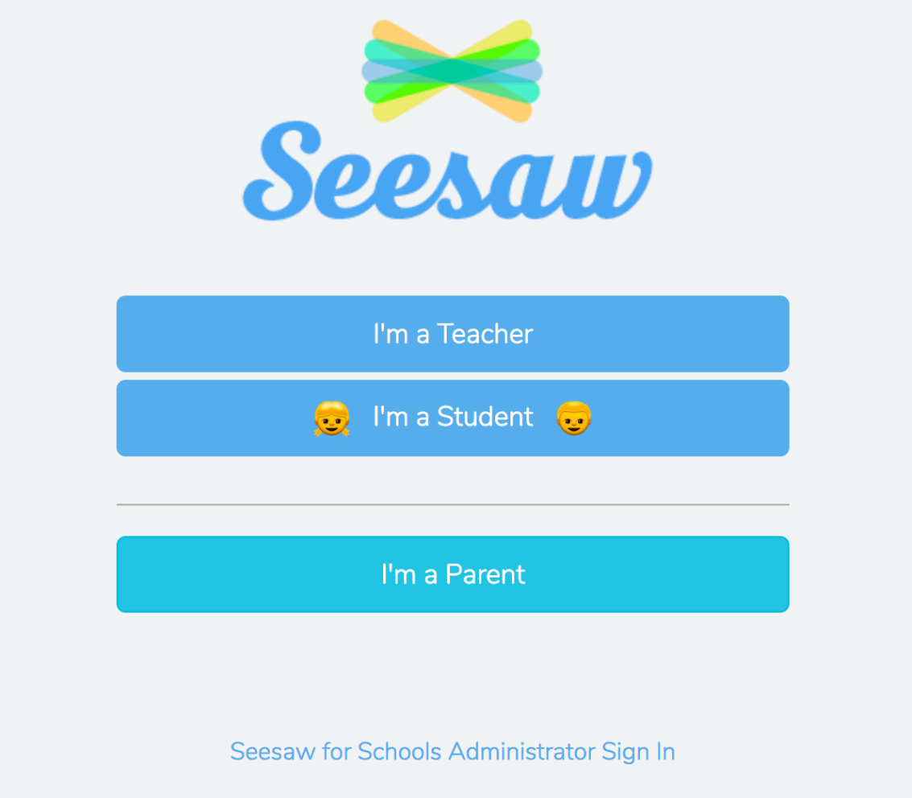
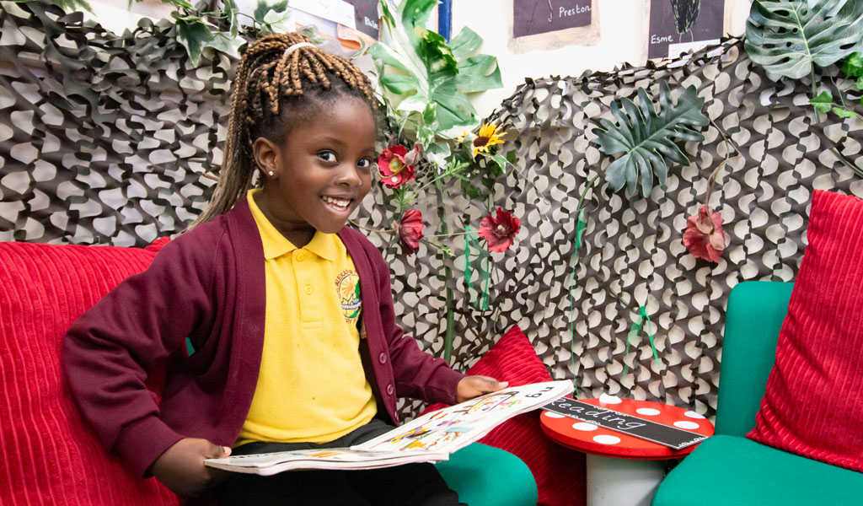
Early Reading and Writing
Books
Story focus
Nursery rhymes
Poetry Basket
Squiggle While You Wiggle
Jolly Phonics

Slide 7





Getting ready for school the healthy way . . .
Food
I can use a knife or fork,
or open my lunchbox.
I am happy to try new
foods.
Personal Hygiene
I can go to the toilet.
I can wash my hands.
I can wipe my nose.
Independence
I can recognise
my name.
I know I have
my own
belongings and
and they will
have a special
place at school.
Exercise
I can put my shoes
on and off.
I love to move!
Mental Health
I know it’s ok to feel
nervous about new
things.
I know I can ask my
teachers for help.

Slide 8
Key Dates
Lunch date - Monday 6th July at 11:30am
Home visits – Thursday 18th/ Friday 19th June
Stay and Play sessions (just children) –
Monday 22nd June @ 9:30-11am
Monday 29th June @ 1:45-2:45pm
School starts on Wednesday 2nd September 2026
Please complete the admissions forms now.

